Slide 1
Journey
Noah Pritchard, Luisa Ball, Kyle Vitale, Sudarshan Swamy
Notes:
What are you building and why ? Motivation (why build it)? Goals? Users ? Why/how is it different from current products/products/research ?

Slide 2
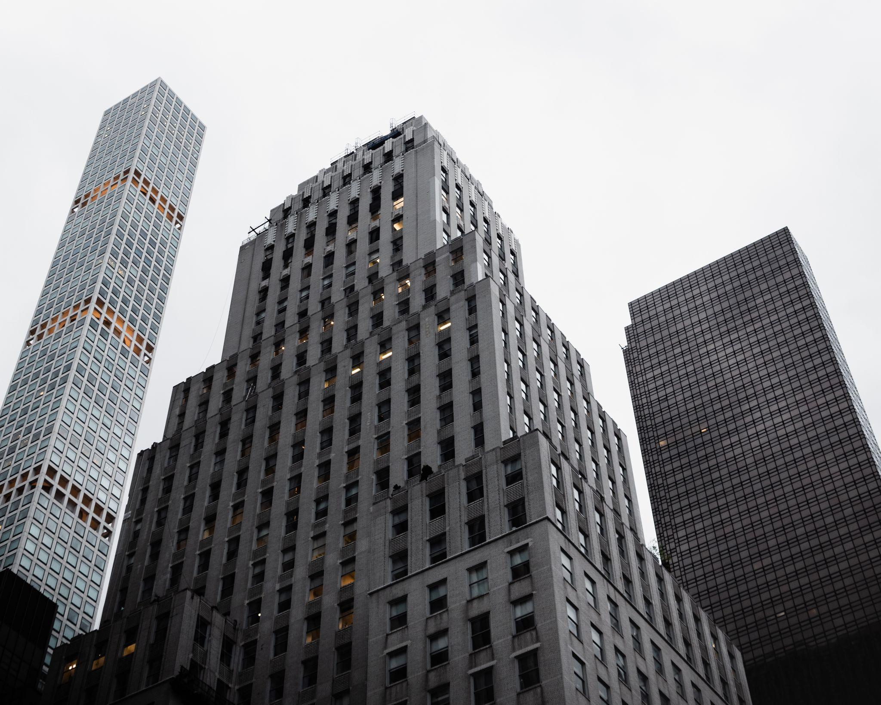
Notes:
Kyle’s heat map (story)
Did not really explore the city which is a problem that many people face when in a new city. Which leads us to our users

Slide 3
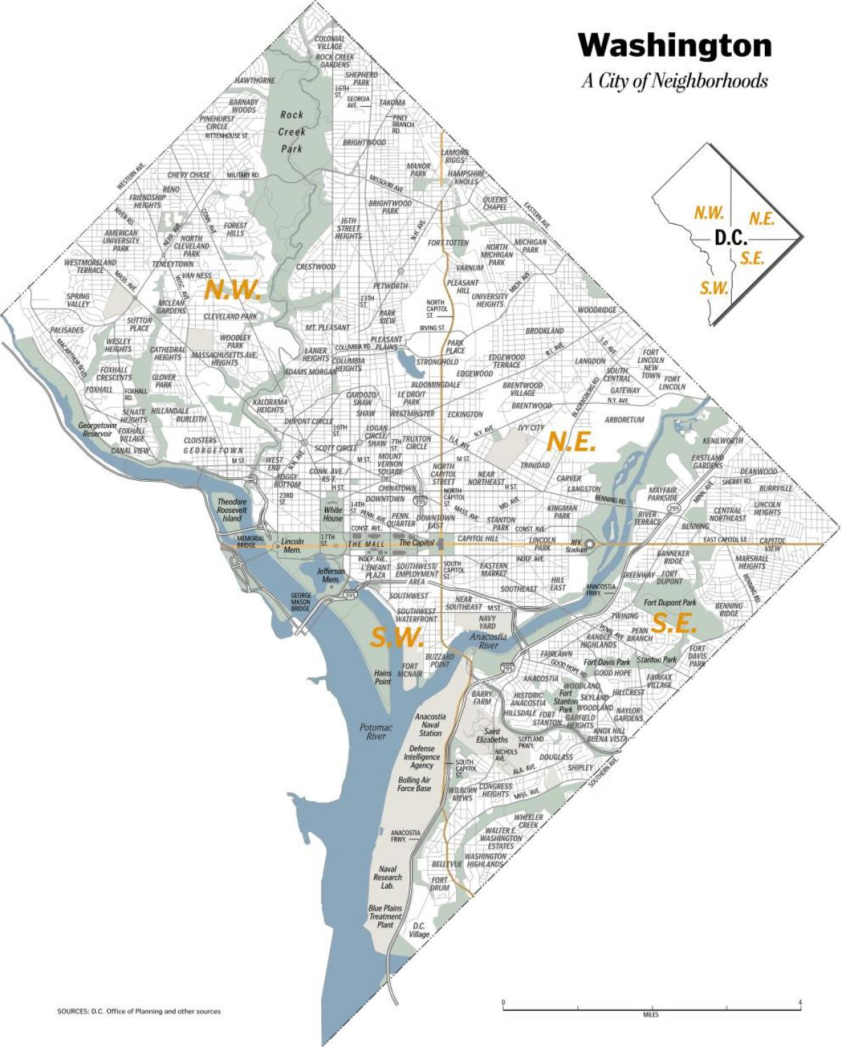
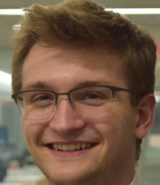
Welcome to DC!
Notes:
Kyle’s heat map (story)
Did not really explore the city which is a problem that many people face when in a new city. Which leads us to our users

Slide 4



Welcome to DC… in the Summer!
Notes:
Kyle’s heat map (story)
Did not really explore the city which is a problem that many people face when in a new city. Which leads us to our users

Slide 5


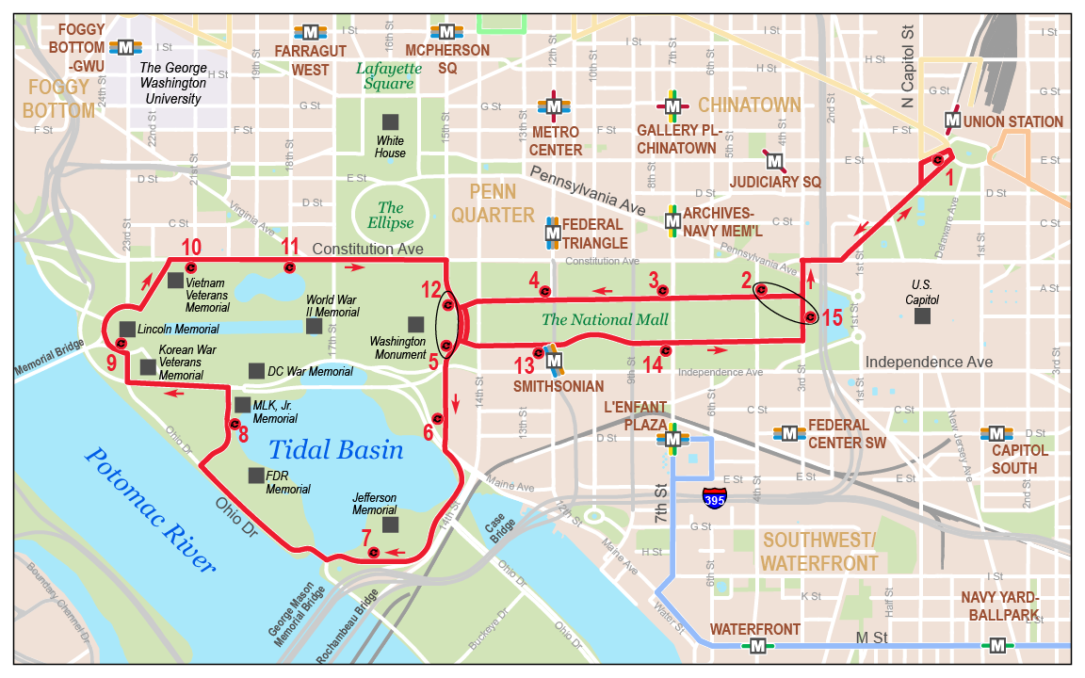
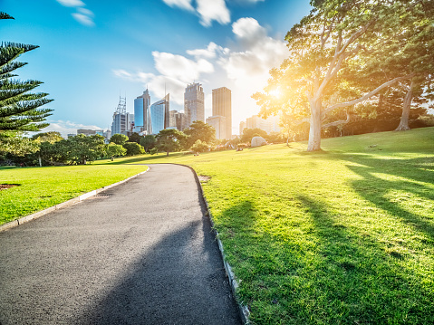
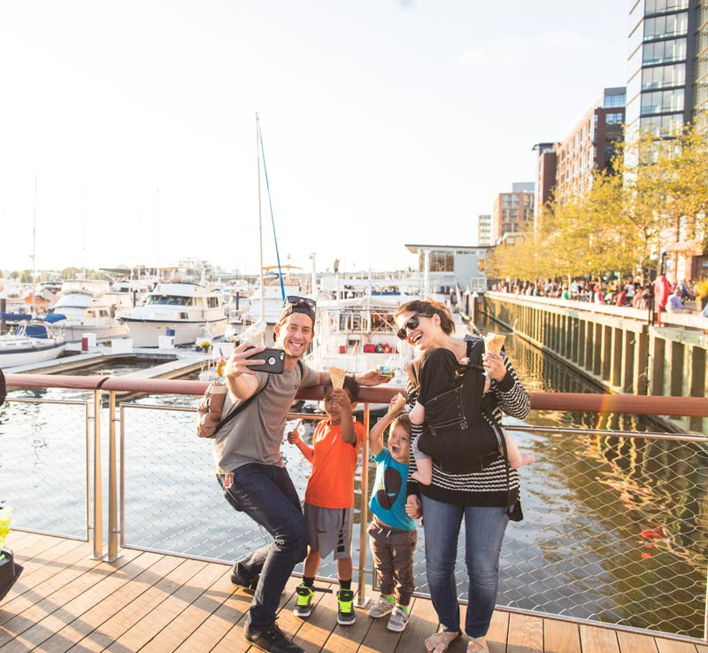
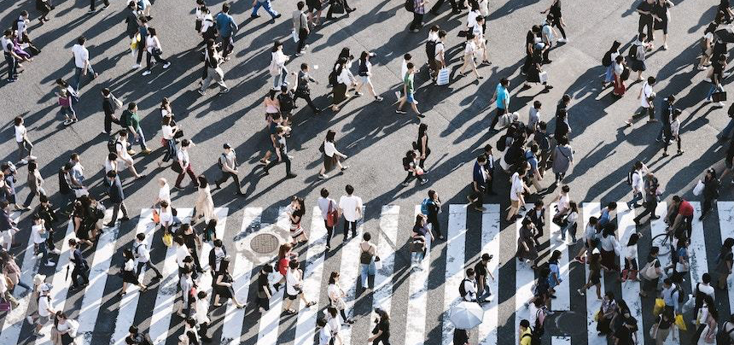
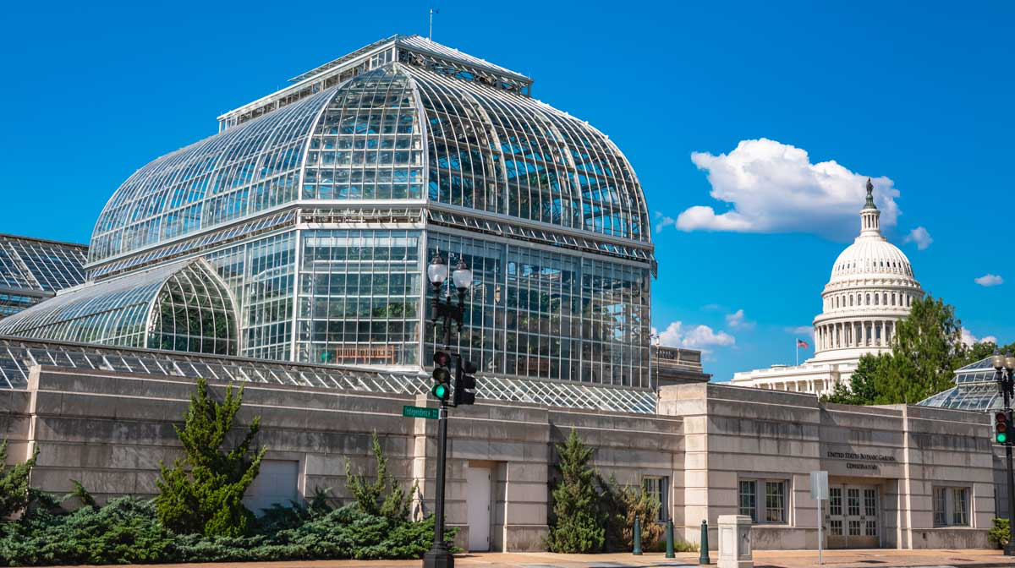
Our Users
The Problem
Residents
Tourists

Slide 6
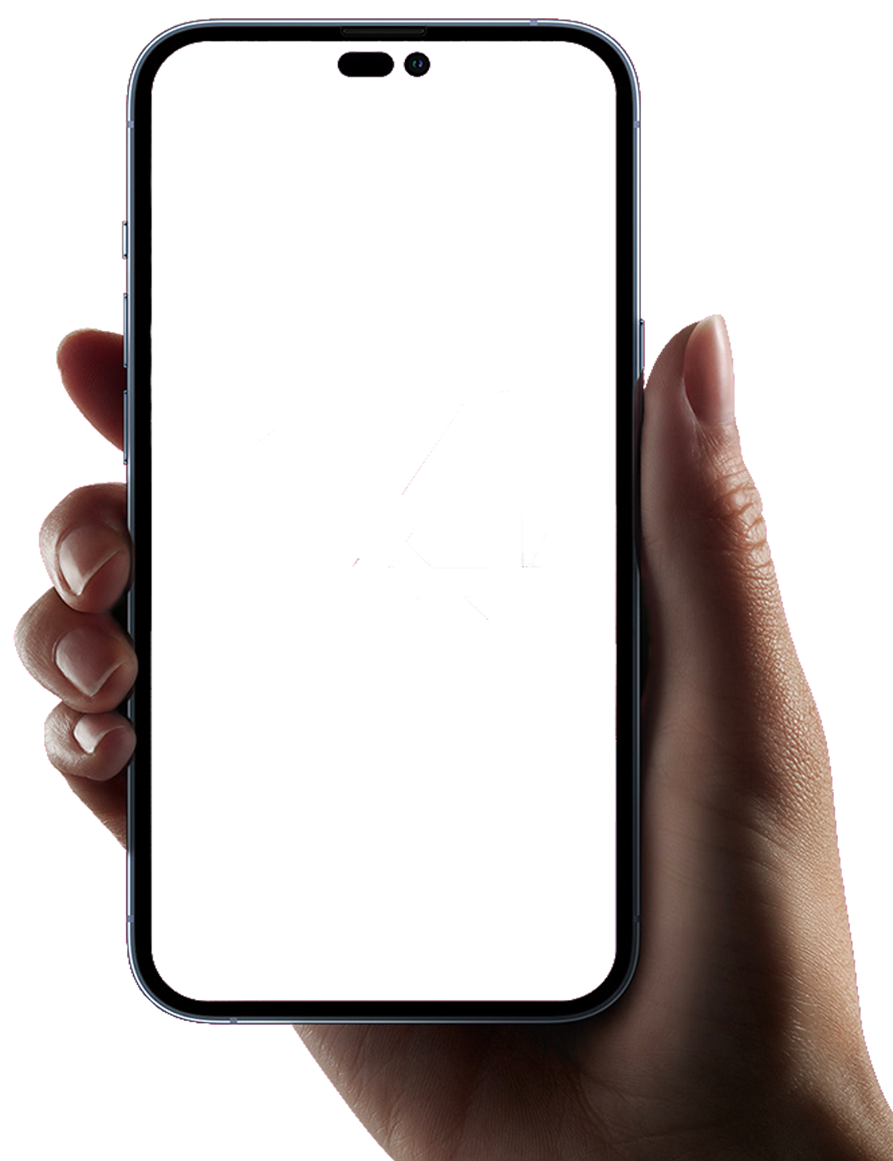
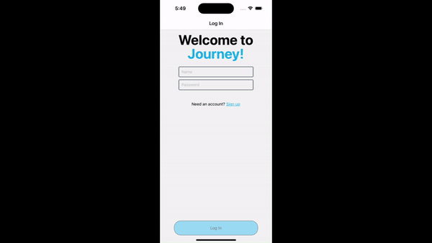
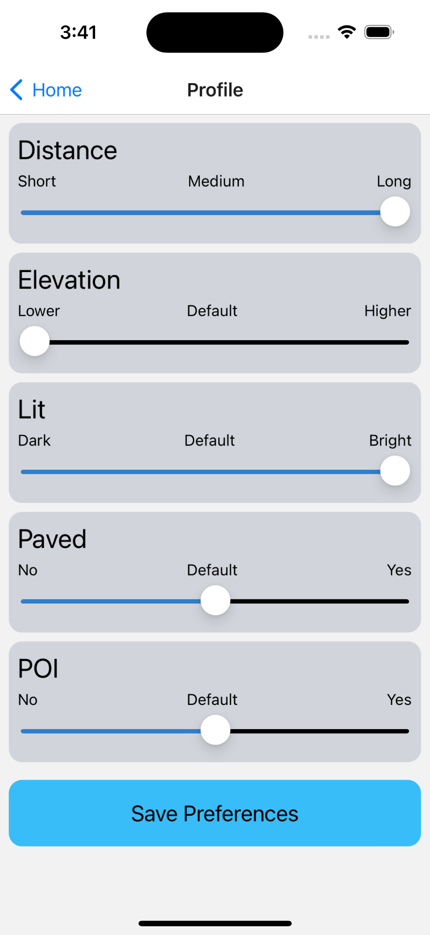
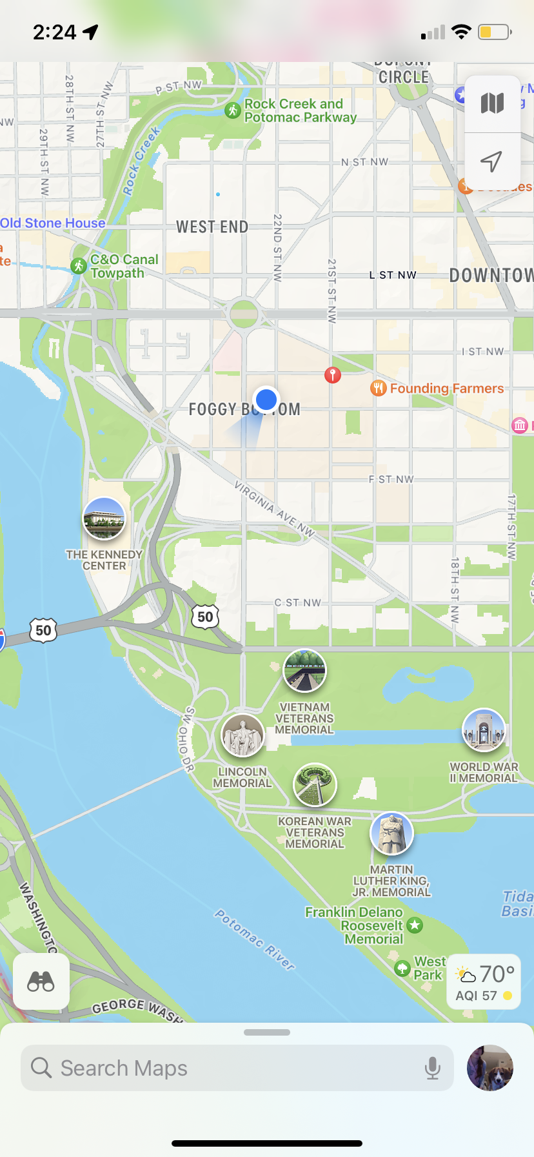

Our App
Access to personalized routes, recommendations, tours of different locations
Circular path adjusted depending on user preferences
Notes:
Shade, Distance, elevation, whether is paved and how lit is the path at night
Use this slide to present what our app looks like and does

Slide 7
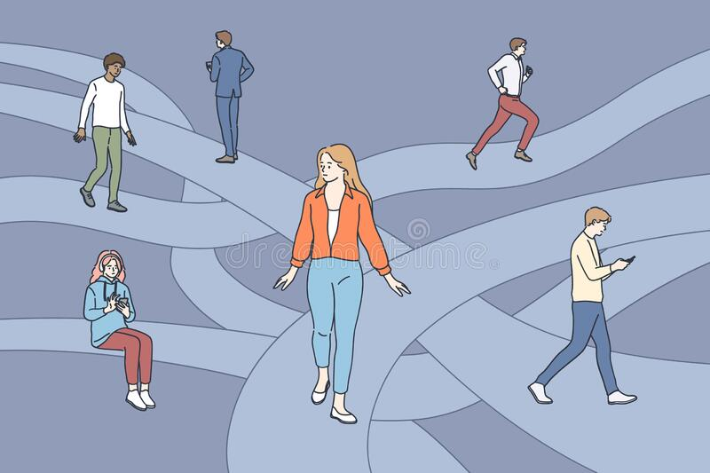
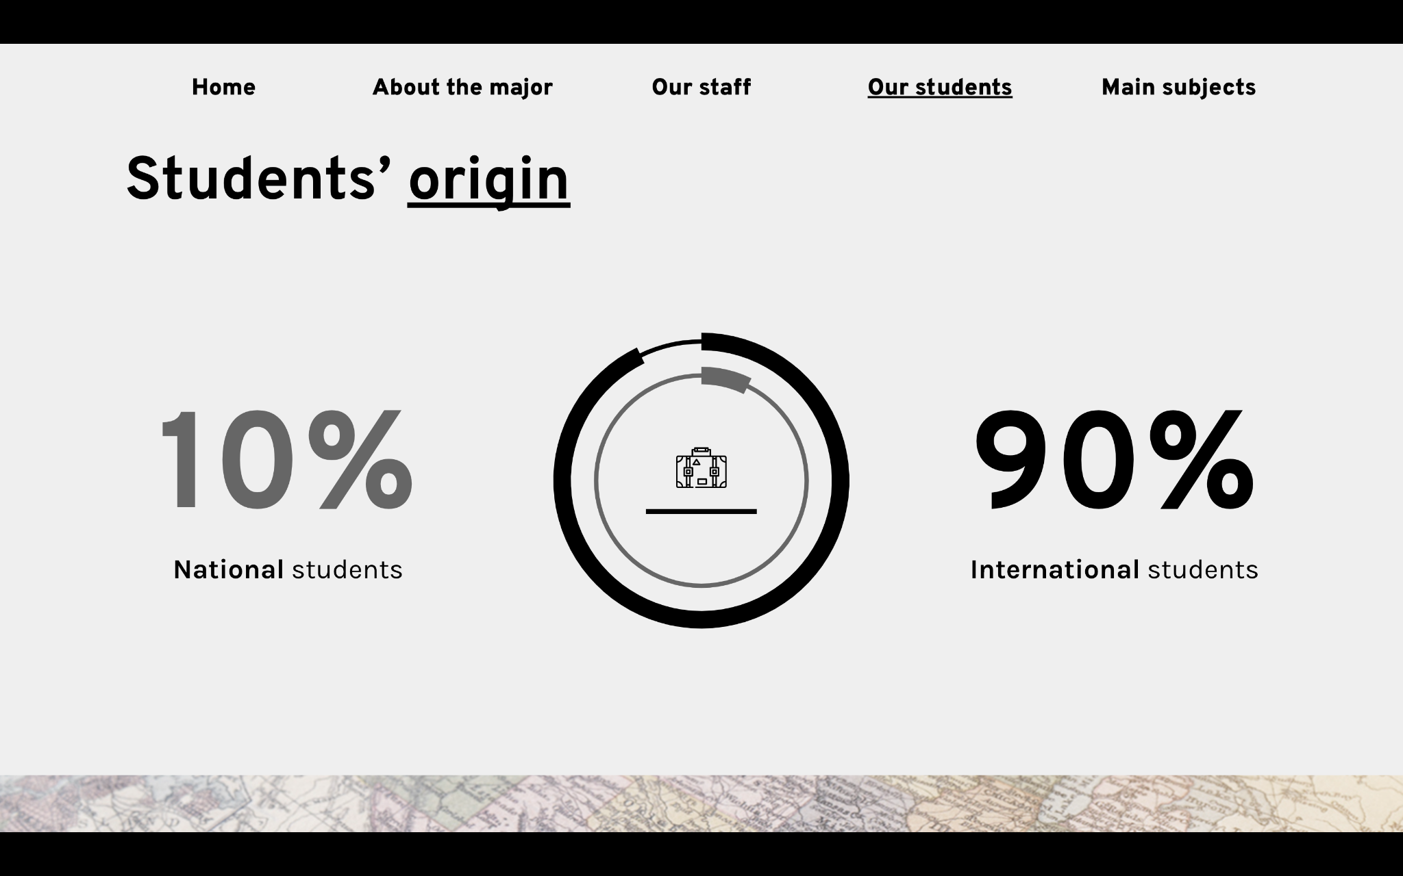
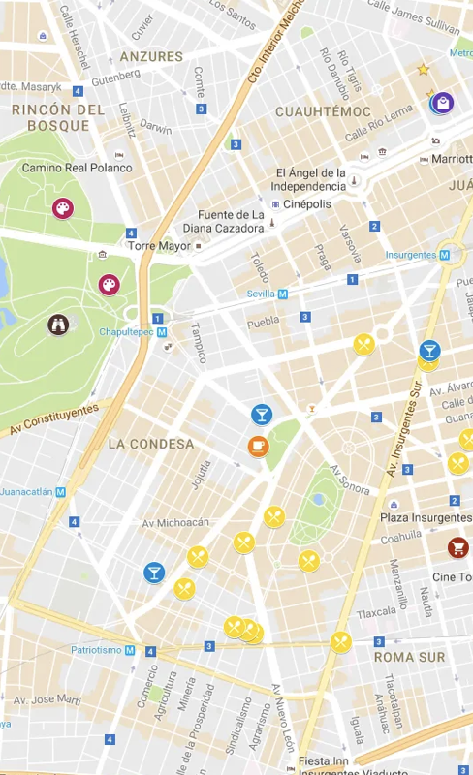

Innovation
User preferences
Journey gives its users valuable experiences
Provide the best personal routes for our users
Notes:
Shade, Distance, elevation, how lit is the path at night, whether it is paved, and POI
We offer users a variety of selections in order to provide them with a valuable personalized experience since a good walk looks different for everyone
Innovative never seen before shade Algorithm unique to our app
With our app
Change success into what we did and what we achieve through it
n interactive, maps-based experience for users centered around exploring their chosen location.
A good walk should look different for different users with different preferences
Provide the best personal experience for our users

Slide 8
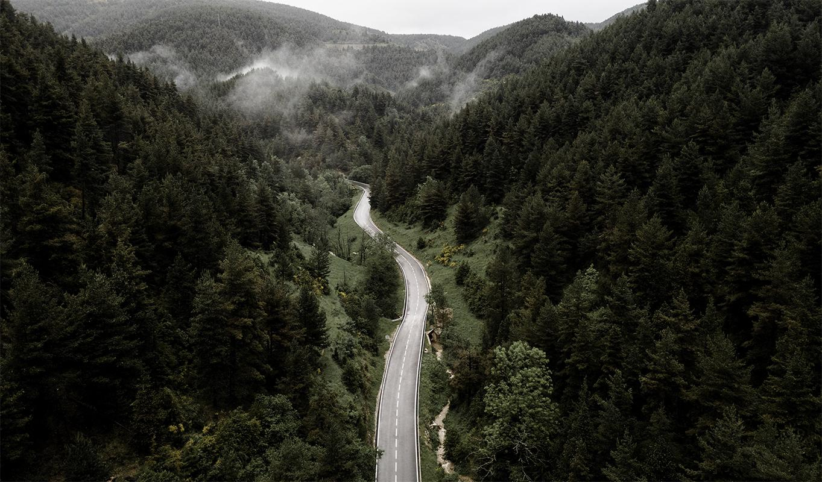

Questions?
Journey

